Slide 1
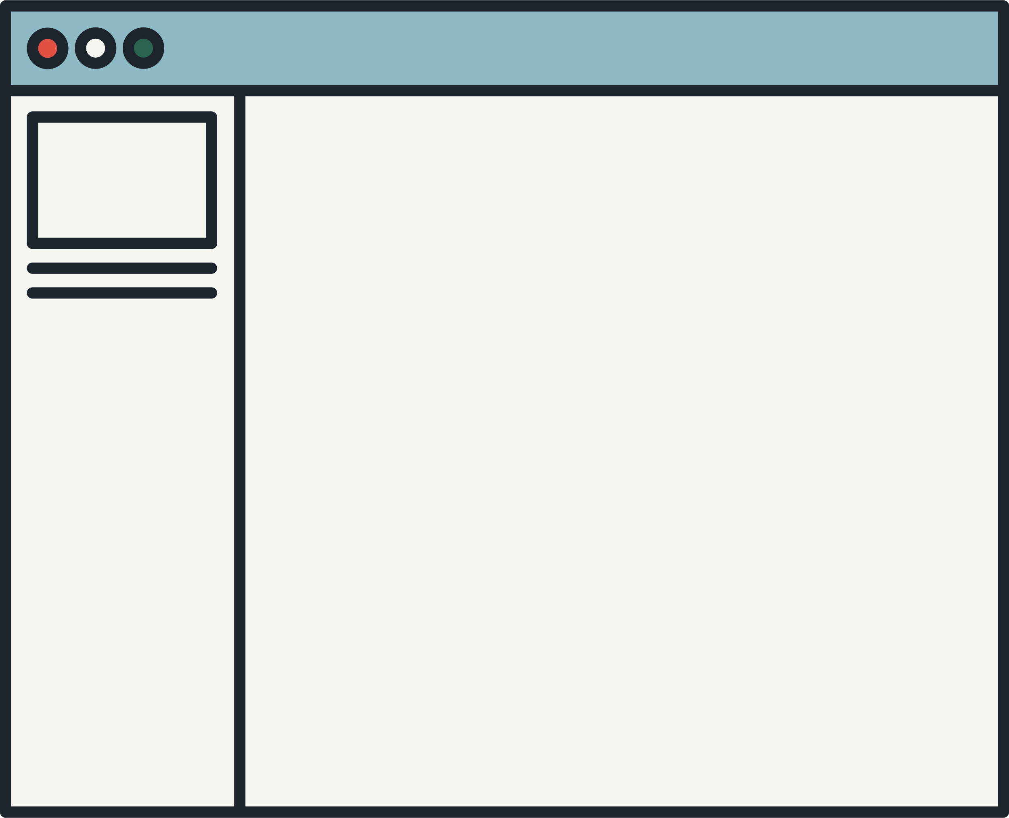



IMPLEMENTATION OF 32-QAM
TX-RX SYSTEM USING MATLAB

Slide 2
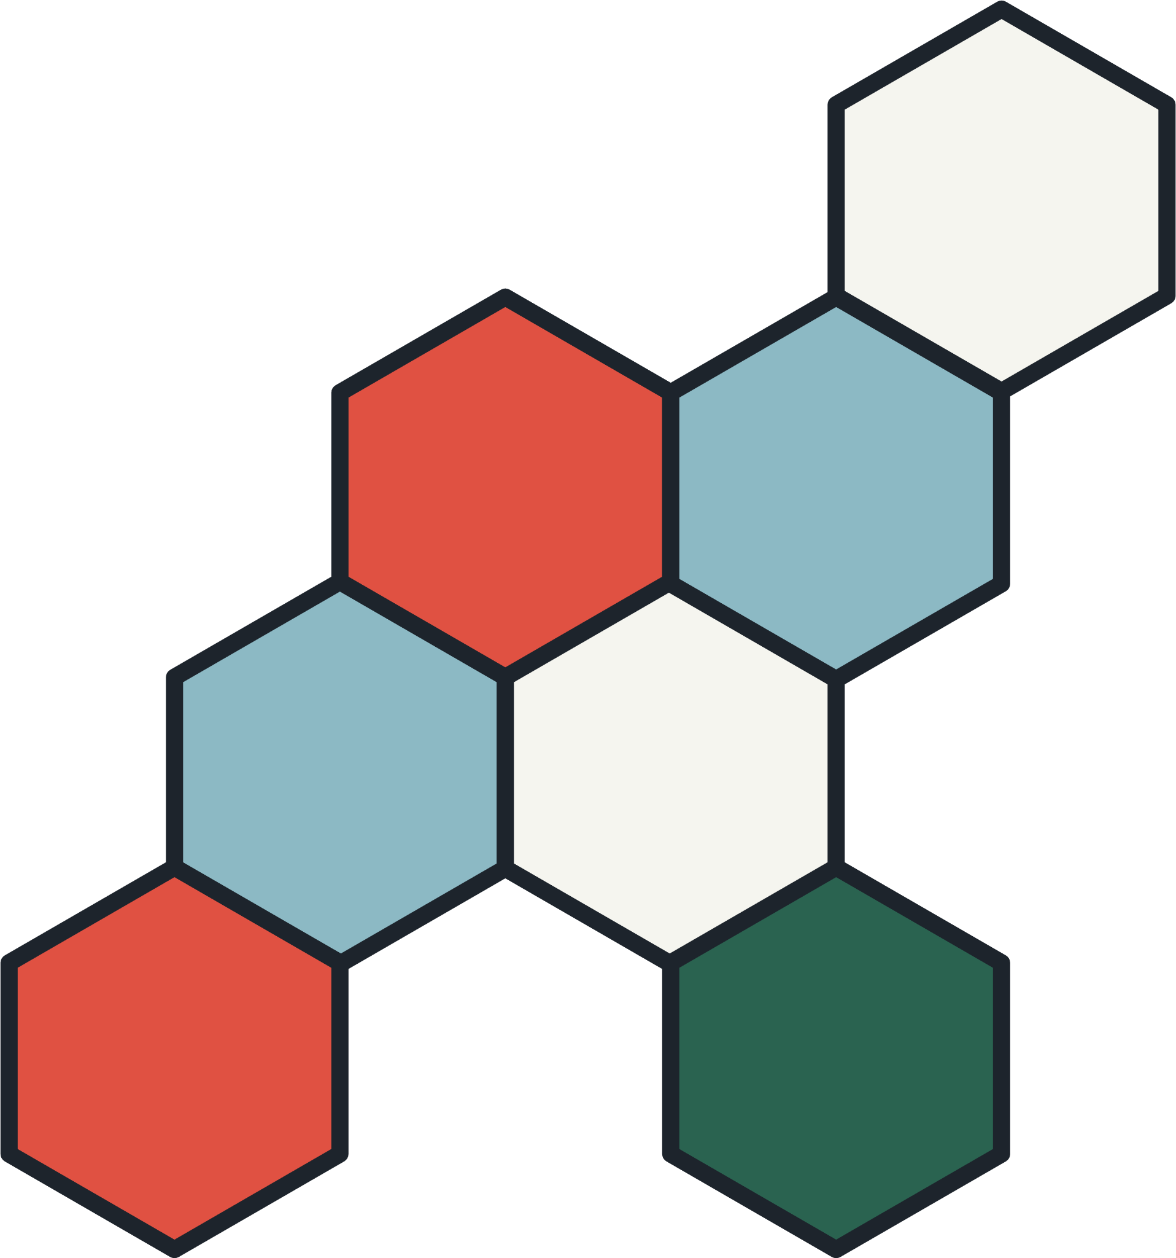



INTRODUCTION
DIGITAL MODULATION IS AN IMPORTANT MODULATION SCHEME IN MODERN COMMUNICATION SYSTEMS AS IT IS MORE EFFICIENT THAN ANALOG MODULATION
FIRST, IT CAN TRANSMIT LARGE AMOUNTS OF DATA OVER LONG DISTANCES WITHOUT SIGNIFICANT LOSS OF THE MODULATION SIGNAL.
SECOND IS THAT BY ENCODING THE INFORMATION SIGNAL TO THE CARRIER SIGNAL, THE SIGNAL BECOMES LESS SUSCEPTIBLE TO NOISE AND INTERFERENCE
THERE ARE SEVERAL TYPES OF DIGITAL MODULATION SCHEMES:
AMPLITUDE-SHIFT KEYING (ASK)
FREQUENCY-SHIFT KEYING (FSK)
PHASE-SHIFT KEYING (PSK)
QUADRATURE AMPLITUDE MODULATION (QAM)

Slide 3




OBJECTIVES
TO CREATE A TRANSMITTER TO RECEIVER SYSTEM USING QUADRATURE AMPLITUDE MODULATION USING MATLAB
TO BASE THE QUALITY OF QAM TRANSMITTER (TX) USING RECEIVER (RX) SYSTEM ON THE BIT ERROR RATE(BER) OF THE RECEIVED SIGNAL
TO TEST THE NOISE TOLERANCE OF THE SYSTEM BY IMPLEMENTING SEVERAL SIGNAL-TO-NOISE RATIO (SNR)

Slide 4


THEORETICAL CONSIDERATIONS
QAM
This modulation scheme uses two carrier waves; amplitude and phase of each carrier wave represents the Digital Data.
FILTER
In the context of QAM system, filters serves multiple purposes such as limiting the bandwidth and noise rejection.
FAST FOURIER TRANSFORM
This algorithm was used in the project for performing signal analysis and filter design.

Slide 5
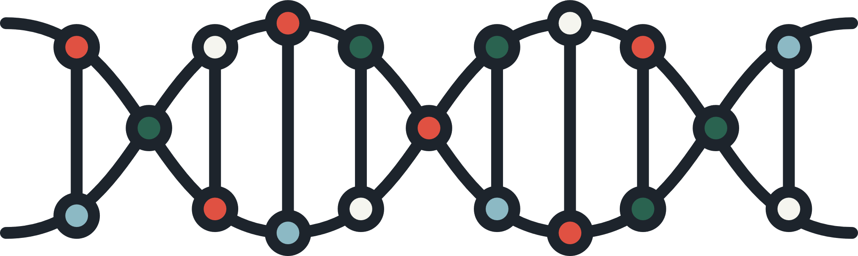

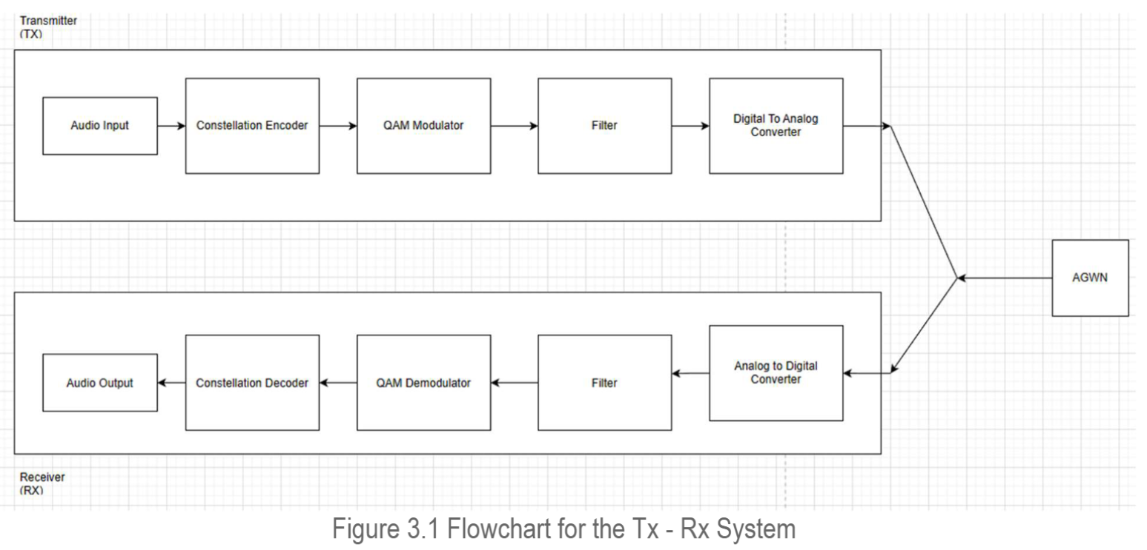
METHODOLOGY
Figure 3.1. Input-Process-Output (IPO) Model

Slide 6
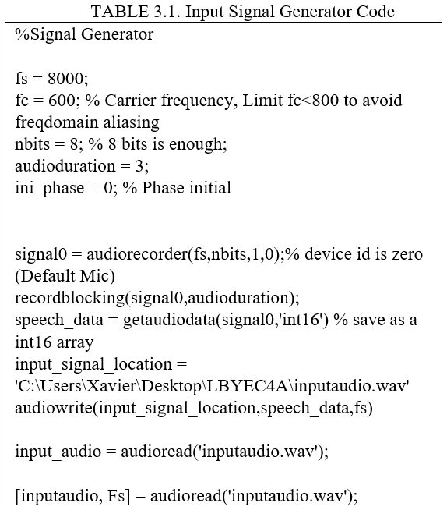
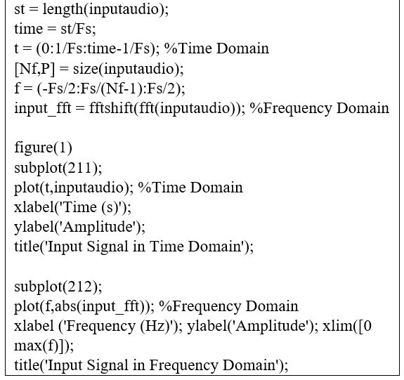
METHODOLOGY

Slide 7
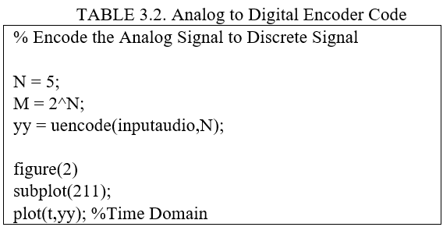
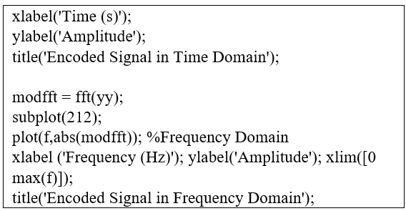
METHODOLOGY

Slide 8
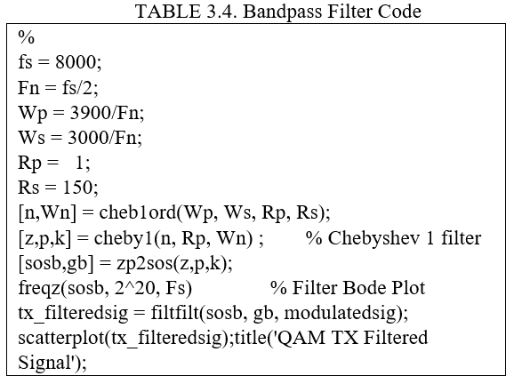
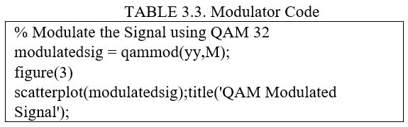
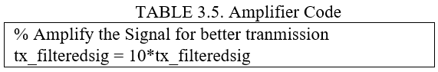
METHODOLOGY

Slide 9
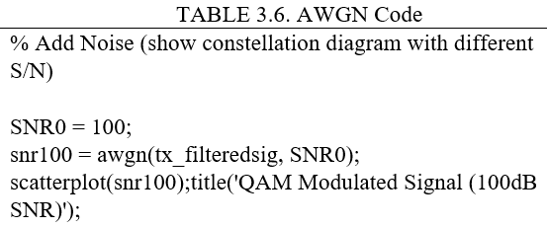
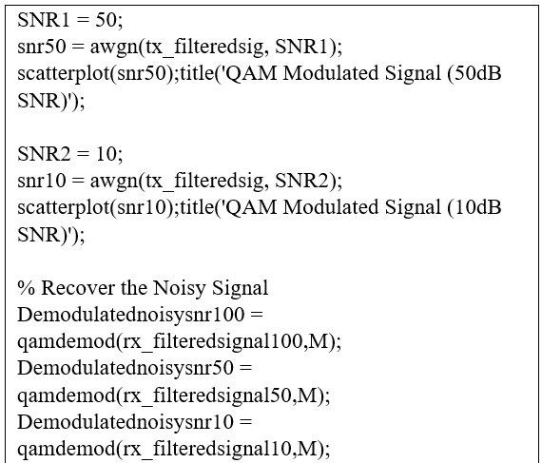
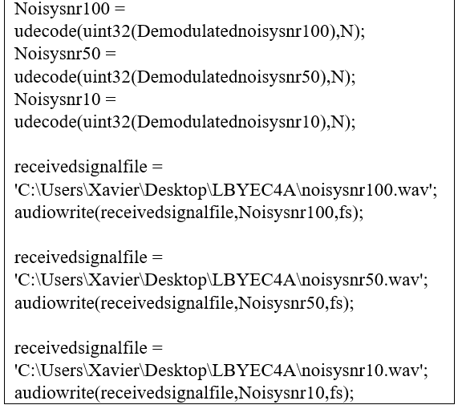
METHODOLOGY

Slide 10
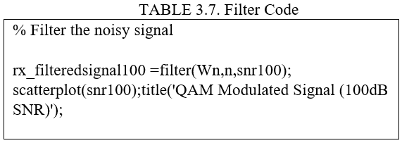
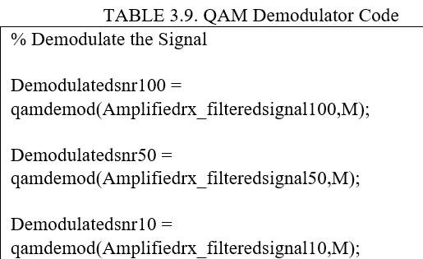
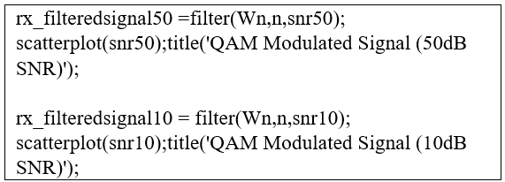
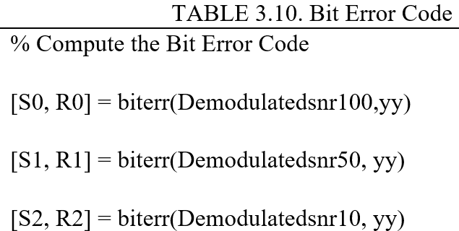
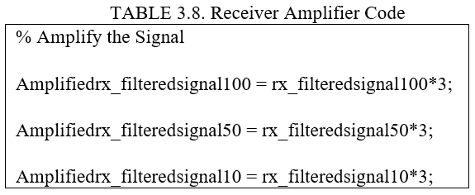
METHODOLOGY

Slide 11
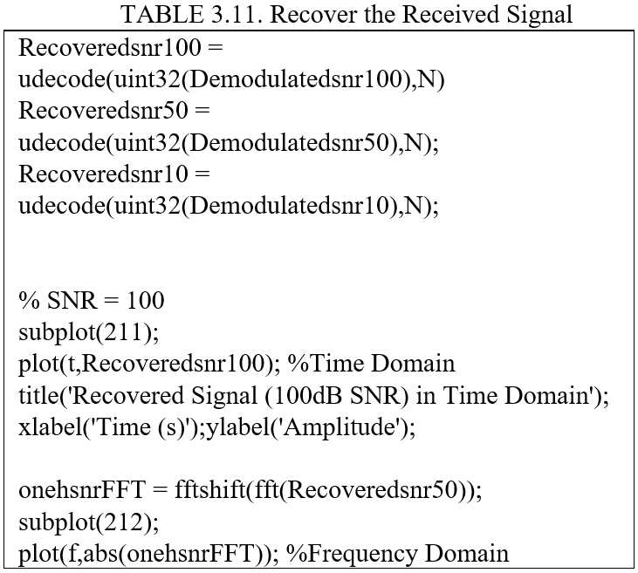
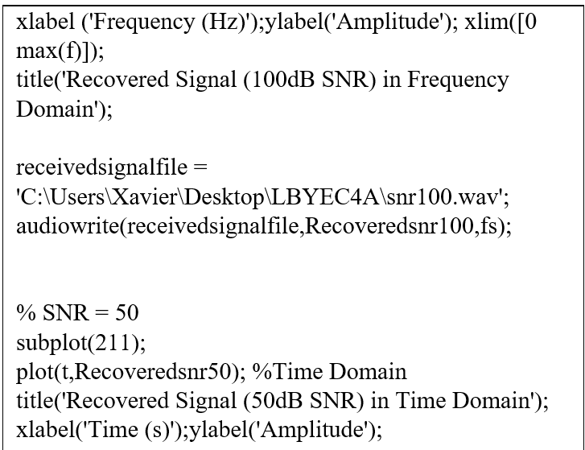
METHODOLOGY

Slide 12
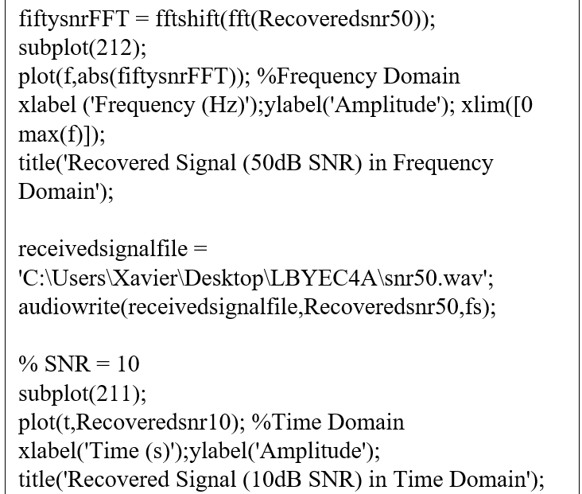
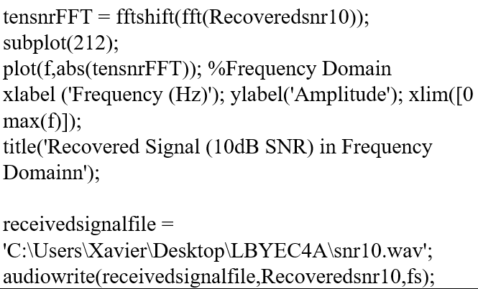
METHODOLOGY

Slide 13

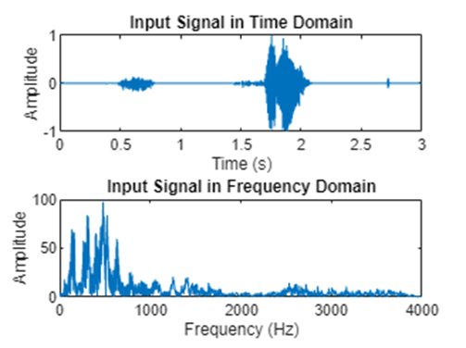
RESULTS

Slide 14
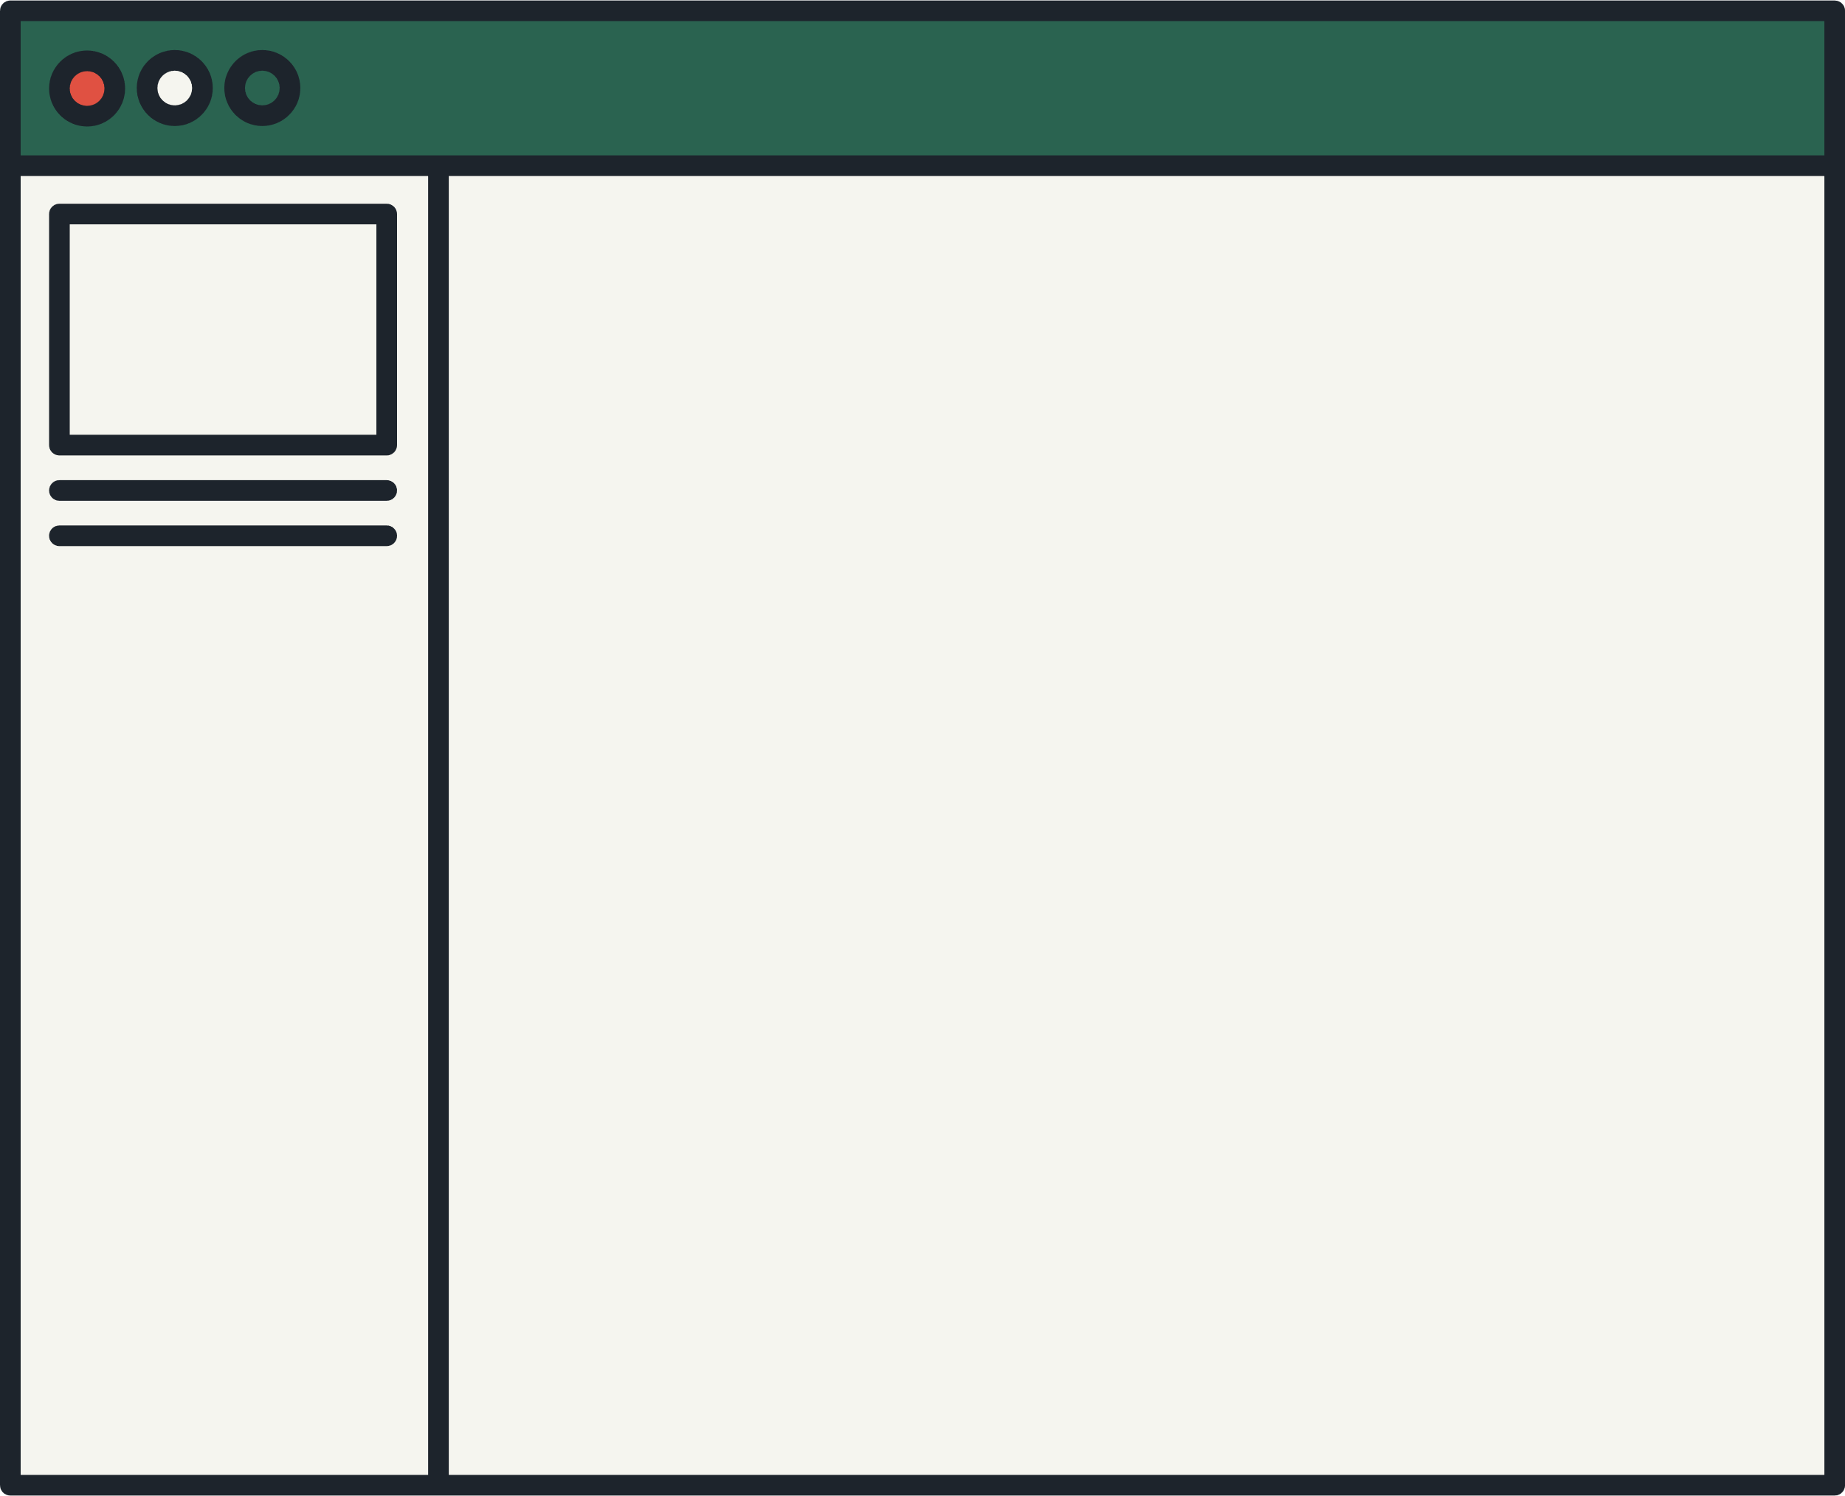
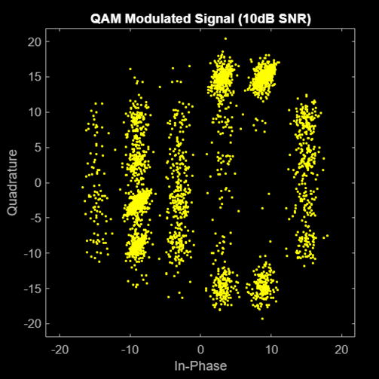
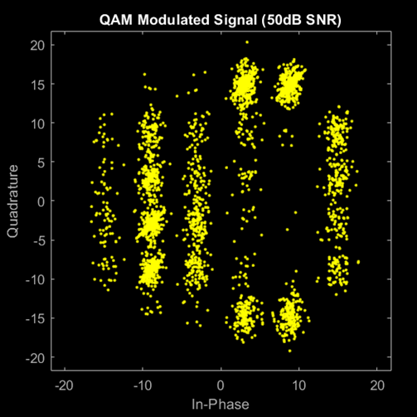
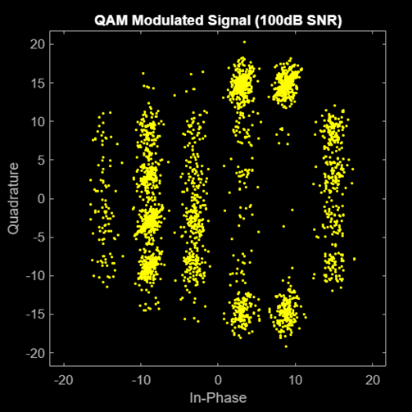
RESULTS

Slide 15
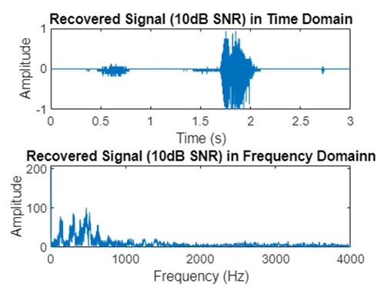
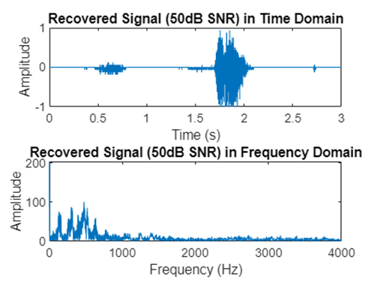

RESULTS

Slide 16
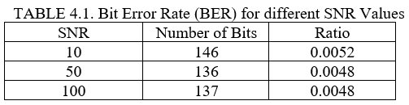
RESULTS

Slide 17




DISCUSSION
The main objective of the project is to create an efficient QAM Tx-Rx System using MATLAB. The results showed that the system was working successfully and there were no major problems that need to be addressed. The audio files show that the input data was not clipped and there were no other signs of data distortion. The BER for the different SNR Values was within the expected range and considered to be good. It also has an inverse relationship with the SNR.
CONCLUSION
In conclusion, the proponent has successfully implemented a QAM Tx-Rx System using MATLAB. The output audio filesshow an audible quality without any major signs of clipping and distortion. The system also the range of a good BER and the results show inverse relationship between the SNR and BER.

Slide 18


REFERENCES
[1] Agarwal, T. (2020, January 13). Digital Modulation : Types and Differences between Analog and Digital. ElProCus - Electronic Projects for Engineering Students. https://www.elprocus.com/digital-modulation-different-types-and-their-differences/
[2] Agarwal, T. (2019, September 11). Amplitude Shift Keying : Circuit Diagram, Working and Its Applications. ElProCus - Electronic Projects for Engineering Students. https://www.elprocus.com/amplitude-shift-keying-ask-working-and-applications/
[3]Agarwal, T. (2019b, September 11). Frequency Shift Keying (FSK) :Working, Advantages and Disadvantages. ElProCus - Electronic Projects for Engineering Students. https://www.elprocus.com/frequency-shift-keying-fsk-working-applications/.
[4]Y, R. (2020, December 10). What is Phase Shift Keying (PSK)? BPSK modulation, BPSK demodulation, advantages, disadvantages and applications of PSK - Electronics Coach. Electronics Coach. https://electronicscoach.com/phase-shift-keying.html
[5] Zola, A. (2021, August 16). QAM (quadrature amplitude modulation). Networking. https://www.techtarget.com/searchnetworking/definition/QAM
[6] What is a good bit error rate? – Sage-Answer. (2020, November 13). https://sage-answer.com/what-is-a-good-bit-error-rate/
[7] Altunian, G. (2021, August 12). What Is Signal-to-Noise Ratio and Why Does It Matter? Lifewire. https://www.lifewire.com/signal-to-noise-ratio-3134701
[8] MathWorks. (n.d.). Add white Gaussian noise to signal - MATLAB awgn. https://www.mathworks.com/help/comm/ref/awgn.html
[9] Xia, Z. (2022, April 2). What Is QAM? How Does QAM Work? - Huawei. Huawei. https://info.support.huawei.com/info-finder/encyclopedia/en/QAM.html
[10] Y, R. (2018b, December 12). What is a Bandpass Filter? Definiton, design, response curve and applications of Bandpass Filter - Electronics Coach. Electronics Coach. https://electronicscoach.com/bandpass-filter.htmL
[11] Agarwal, T. (2015, June 16). Chebyshev Filter - Diffferent Types of Chebyshev Filters. ElProCus - Electronic Projects for Engineering Students. https://www.elprocus.com/types-of-chebyshev-filters/
[12] MathWorks. (n.d.-b). Fast Fourier Transform (FFT). MATLAB & Simulink. https://www.mathworks.com/discovery/fft.html
[13] proAV / data and information, lists, tables and links. (n.d.). https://av-info.eu/index.html?https&&&av-info.eu/audio/speech-level.html
[14] MathWorks. (n.d.-c). Quadrature amplitude modulation (QAM) - MATLAB qammod. https://www.mathworks.com/help/comm/ref/qammod.html

Slide 19
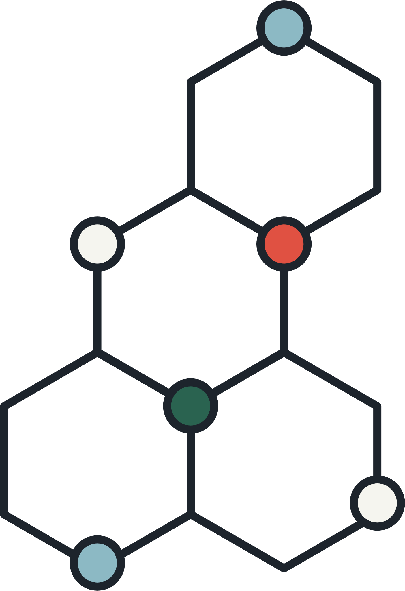


THANK YOU!
GUIMALAN, POZAS, SABINO

